Slide 1


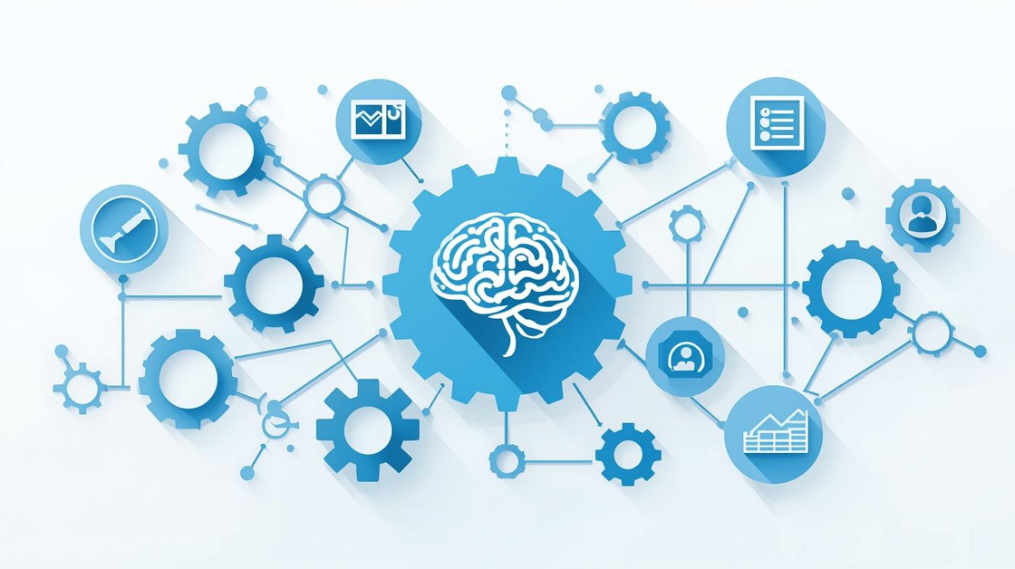
TalentFlow AI
Presented by
Tallapalli Uday Krishna
1

Slide 2

Business Challenges
Slow Manual Processes in Recruitment
Recruiter Fatigue
Exhaustion complicate decision-making, hindering fair assessments.
Inefficiencies - traditional hiring leads to delays and frustration.
Resume Overload and Low Efficiency
Inconsistent Job Descriptions
Inconsistent job descriptions confuse candidates and reduce applications due to poor tone, clarity, and structure.
Recruiters waste hours going through piles of resumes, causing slow hiring and missed talent.
2

Slide 3
Real-World Challenges
High Volume of Resumes
Inconsistent Evaluations
Slow Hiring Processes
Recruiters face an overwhelming influx of applications daily.
Assessments vary widely, leading to biased hiring decisions.
Lengthy recruitment cycles affect candidate engagement and satisfaction.
3

Slide 4
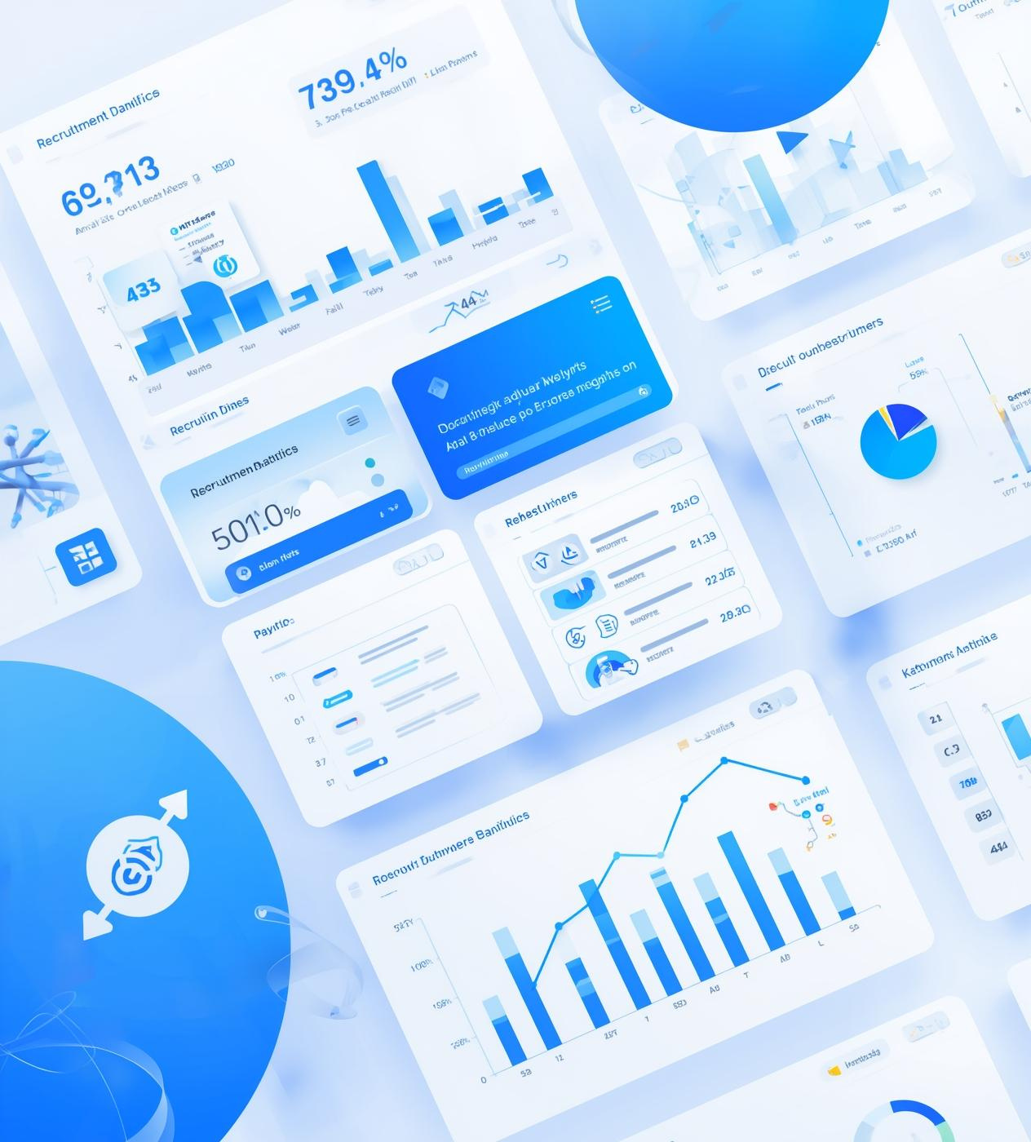
About TalentFlow AI
Streamlining recruitment with innovative solutions
TalentFlow AI enhances recruitment efficiency through automated resume screening, job description generation, and AI-driven interviews, helping recruiters save time and reduce manual effort in the hiring process.
4

Slide 5
Tools Overview
FastAPI: The Backbone of the Platform
Streamlit: User-Friendly Frontend
Databases: MongoDB & ChromaDB
Streamlit simplifies building interactive web applications for users.
Hybrid data management combining MongoDB for flexible user/job storage and ChromaDB for fast semantic resume retrieval.
FastAPI enables fast and efficient API development for integration.
Frameworks: LangChain
Azure OpenAI: Advanced AI Capabilities
Whisper & gTTS: Speech-to-Speech AI Pipeline
Orchestrating AI workflows with LangChain for seamless LLM integration and pipeline management.
Azure OpenAI offers powerful natural language processing features for automation.
Real-time voice pipeline combining Whisper for accurate speech-to-text and gTTS for natural text-to-speech, enabling interactive voice-driven interviews.
5

Slide 6


Architecture
The Architecture Overview of TalentFlow AI highlights the integration of a Streamlit frontend with a FastAPI backend. This framework ensures a responsive user experience, providing real-time data processing and seamless interactions while maintaining robust performance and scalability for future enhancements and features.
6

Slide 7
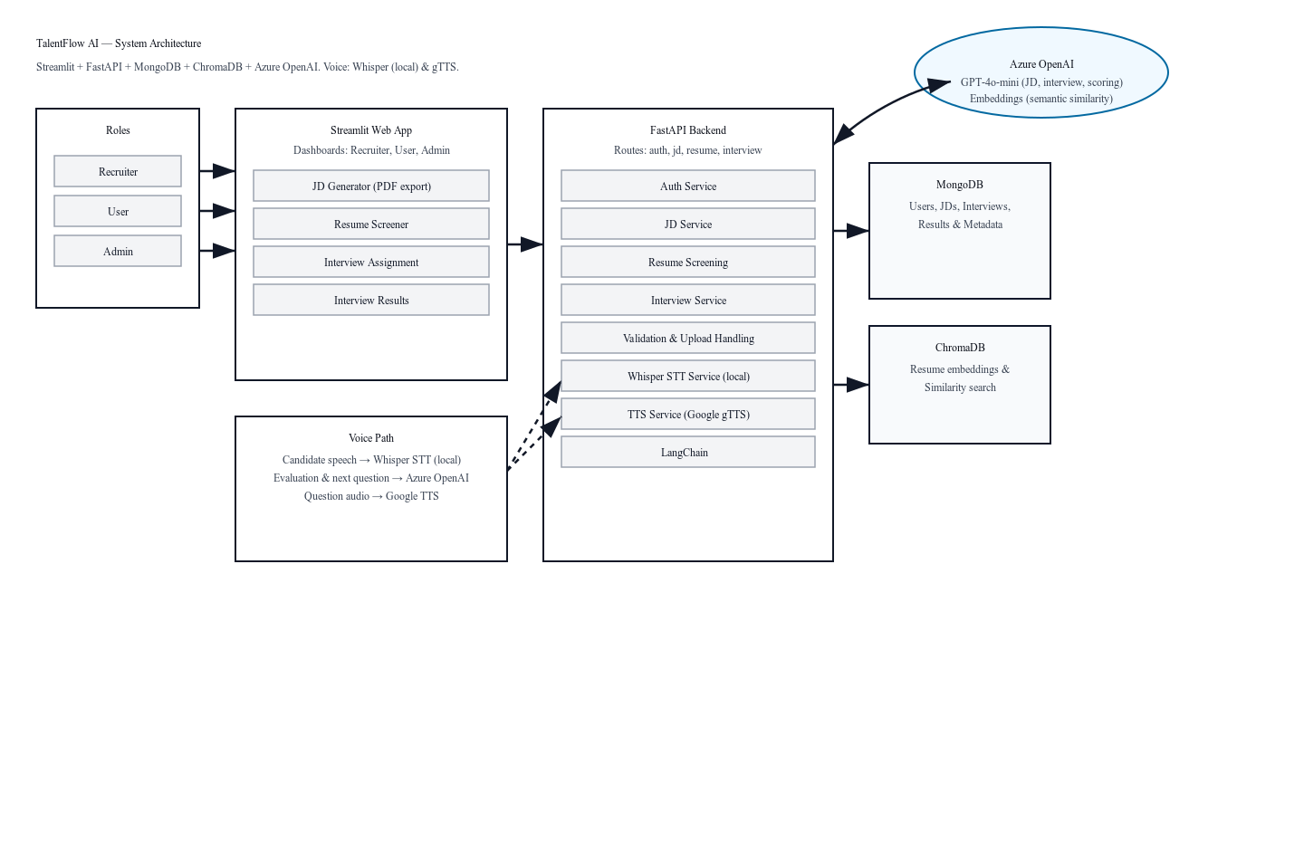
Architecture Digram
7

Slide 8
Workflows Explained
Streamlined Resume Screening for Efficient Hiring Process
Automated Job Description Generation with AI Support
Quickly identifies top candidates from numerous applications.
Generates tailored job descriptions to attract suitable candidates.
Efficient Interview Assignment for Better Time Management
Engaging AI Interviews with Voice Technology Integration
Assigns interviews based on candidate qualifications and availability.
Enhances candidate experience through interactive voice interviews.
8

Slide 9



Resume Screening Workflow
Upload Resume & JD
PyPDF2
Text extraction
Recruiter
Embeddings generated
OpenAI
Stored in ChromaDB
Cosine Similarity
Ranked against JD
9

Slide 10
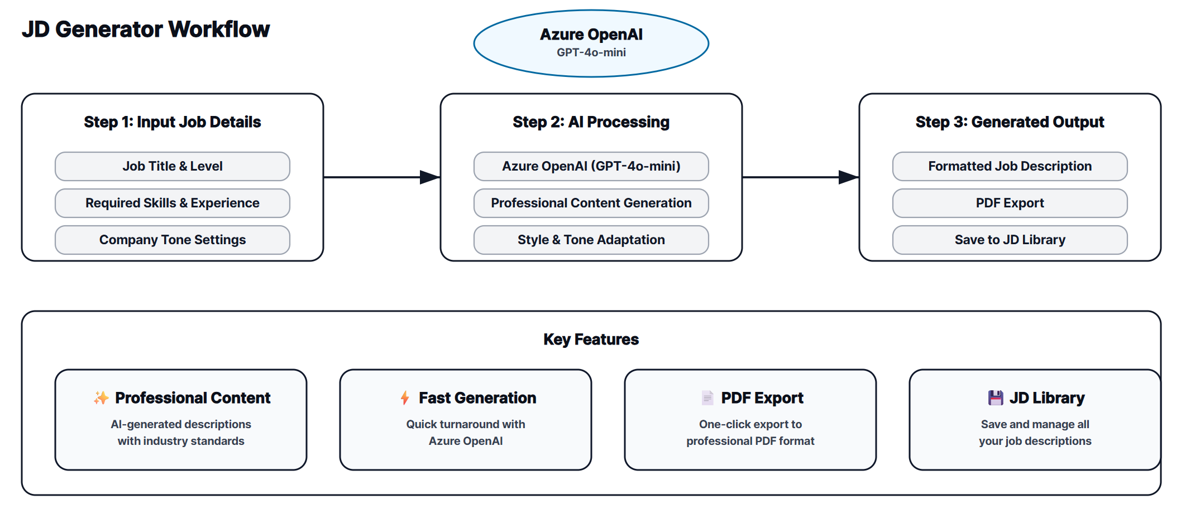
10

Slide 11
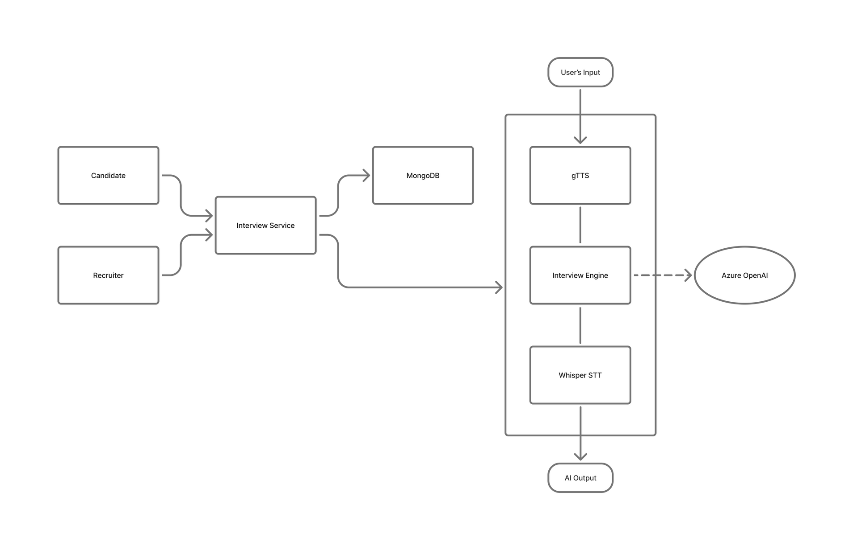
AI-Driven Interview Workflow
11

Slide 12
Challenges
Voice Latency
PDF Parsing
Real-time voice interactions can suffer from delays, affecting user experience and engagement.
Extracting data from PDF resumes presents frequent issues, impacting accuracy and efficiency.
Deployment & Scaling
Ensuring smooth multi-user access without compromising speed or reliability.
12

Slide 13
Future Goals
Expanding to Multilingual Support for Global Reach
Advanced AI Scoring for Candidate Assessment
Seamless Cloud Deployment for Accessibility
Enhancing our platform will include multiple languages support.
Breaking Language Barriers Enable recruiters and candidates to interact in their preferred language, ensuring inclusivity.
Implementing AI scoring will streamline candidate evaluations effectively.
Utilizing cloud deployment will enhance platform accessibility for users.
AI-Powered Resume Reuse and Screening
Timely Email Notifications for Recruiters
Comprehensive Analytics Dashboard for Insights
Storing resumes in ChromaDB enables matching existing or bench employees to new roles, with AI-driven first-round interviews.
Introducing email notifications will keep recruiters informed promptly.
Building an analytics dashboard will provide valuable hiring insights.
13

Slide 14
Demo Showcase
https://drive.google.com/file/d/1RP39DHGF5ktk-KvO94E-Qkqv94nRbf29/view?usp=sharing
14

Slide 15
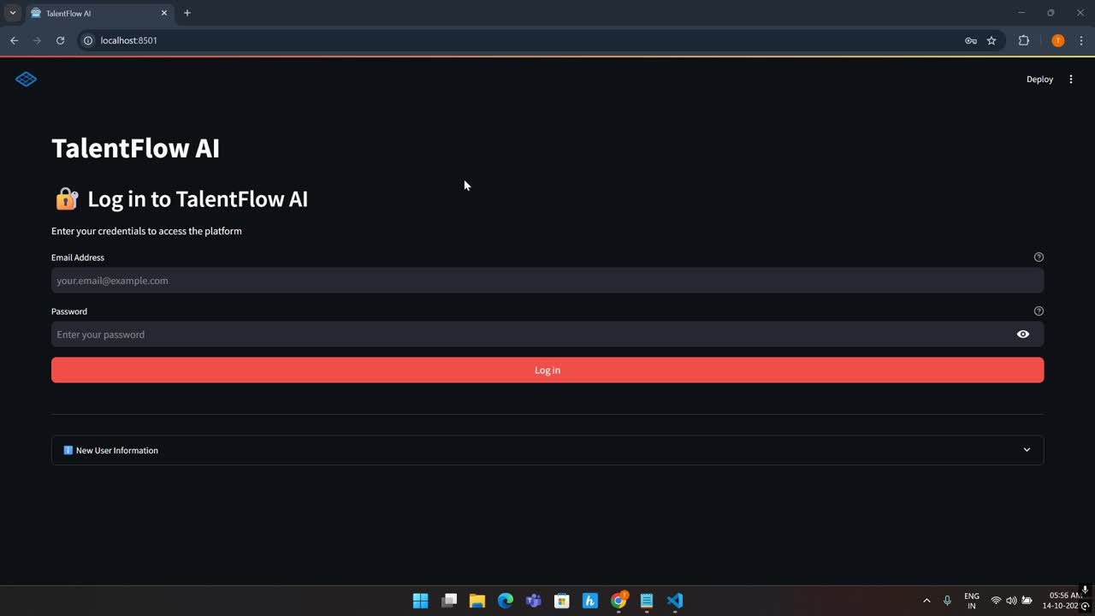
15

Slide 16

Thank You
Email
tallapalliudaykrishna@gmail.com
GitHub
TalentFlow-Al
Phone
+91-8590435974
16

